Slide 1
MONTCLAIR
COMMUNITY
TOWN HALL
With Council Member Peter Yacobellis
October 12, 2022

Slide 2

COVID-19 Consequences for Montclair
Deaths: 83
(3 deaths in 2022)
As of October 11th, 2022

Slide 3
Quick
MONTCLAIR
GOVERNMENT
OVERVIEW

Slide 4
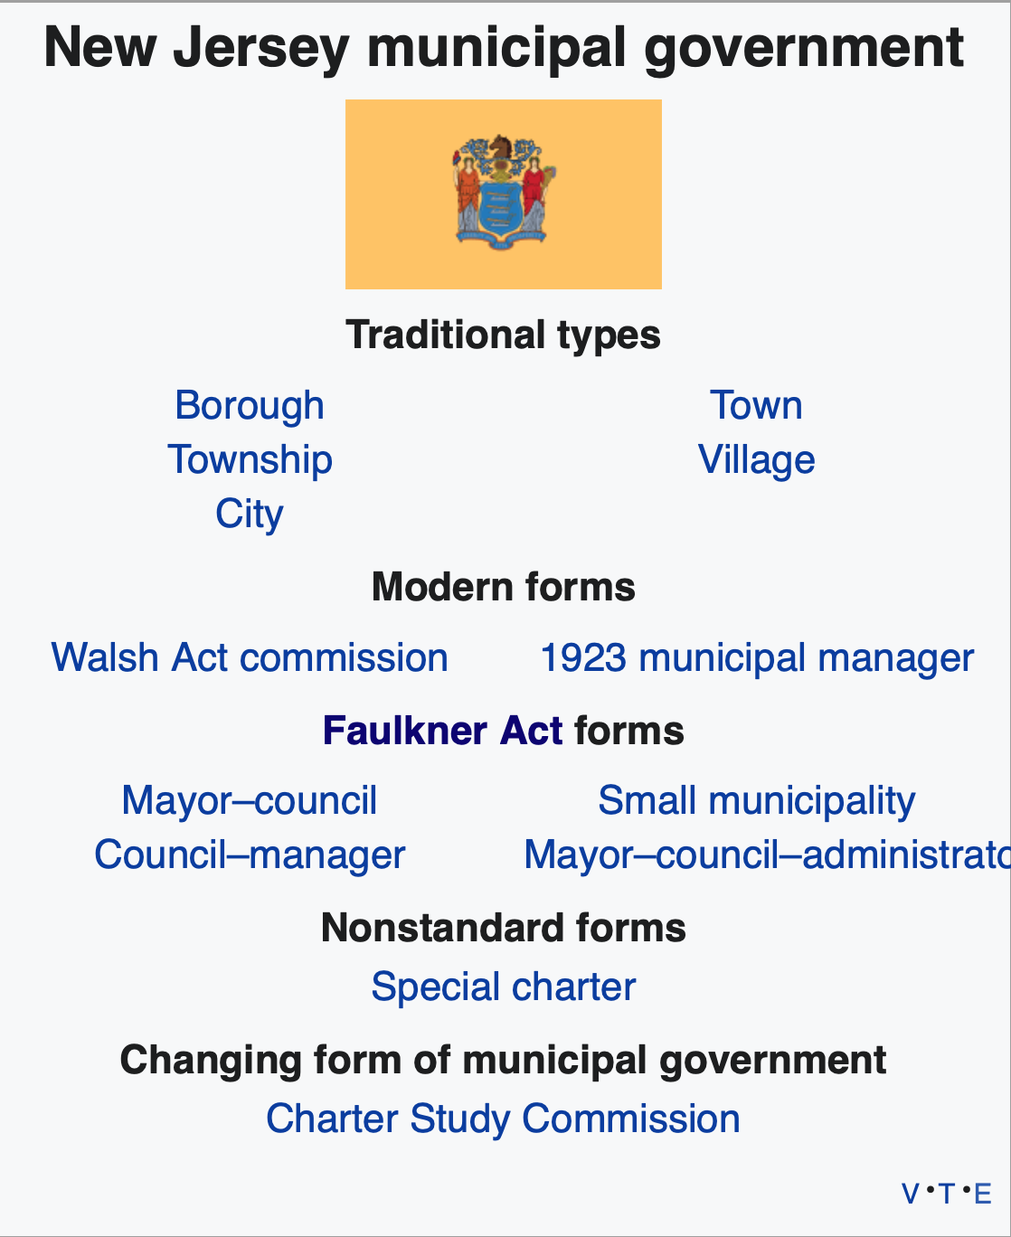
FORM OF GOVERNMENT
Recreate and bold Council-manager
Just Faulkner act info –
4 options and explain Council-Manager
Leave space for example city
“Strong Mayor”
Optional Municipal Charter Law: The Faulkner Act – 4 Distinct Forms of Government with 136 Potential Combinations/Arrangements
The Faulkner Act was created to provide municipalities with greater flexibility than provided in New Jersey's traditional forms of government (city, township, borough, town and village) and to expand on the reforms provided in the Walsh Act and the 1923 Municipal Manager Law.
Mayor –
Council
(67 Municipalities)
Hoboken
Jersey City
Newark
West Orange
Council –
Manager
(41 Municipalities)
Montclair
Livingston
Ridgewood
Verona
Mayor – Council – Administrator
only 3
municipalities
in NJ
Small
Municipality
only 19
municipalities
in NJ
Source: https://en.wikipedia.org/wiki/Local_government_in_New_Jersey |
Learn more about forms of New Jersey Local Government Here: https://www.njlm.org/644/Forms-of-Municipal-Government---New-Jers

Slide 5

MONTCLAIR LEADERSHIP
TOWN COUNCIL
Mayor
Councilor-
at-large
Councilor-
at-large
TOWN MANAGER
Councilor
Councilor
Councilor
Councilor
Town
Manager
Responsible for all legislation, municipal taxes and budget
Annual salary = $10,000 per Councilor; elected to 4-year concurrent terms
Non-partisan elections (no party affiliation declared) in May of Presidential Election Years
Chief Executive Official
Oversees day to day operations
Prepares budget
Appoints/leads department heads
(e.g. police/fire chiefs,
public works, etc.)
Attends Council meetings
with voice, but no vote
Mayor Appoints Boards of:
Council Appoints 10 people:
Library Trustees
Historic Preservation Commission
Limited additional
appointment powers
(e.g. one seat on the Planning Board which he/she may occupy)
Town Manager
Town Attorney
Asst. Town Attorney
Town Clerk
Town CFO
Judge
Prosecutor
Asst. Prosecutor
Public Defender
Tax Assessor

Slide 6
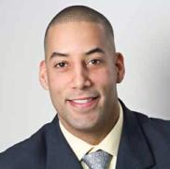

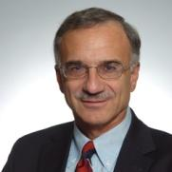
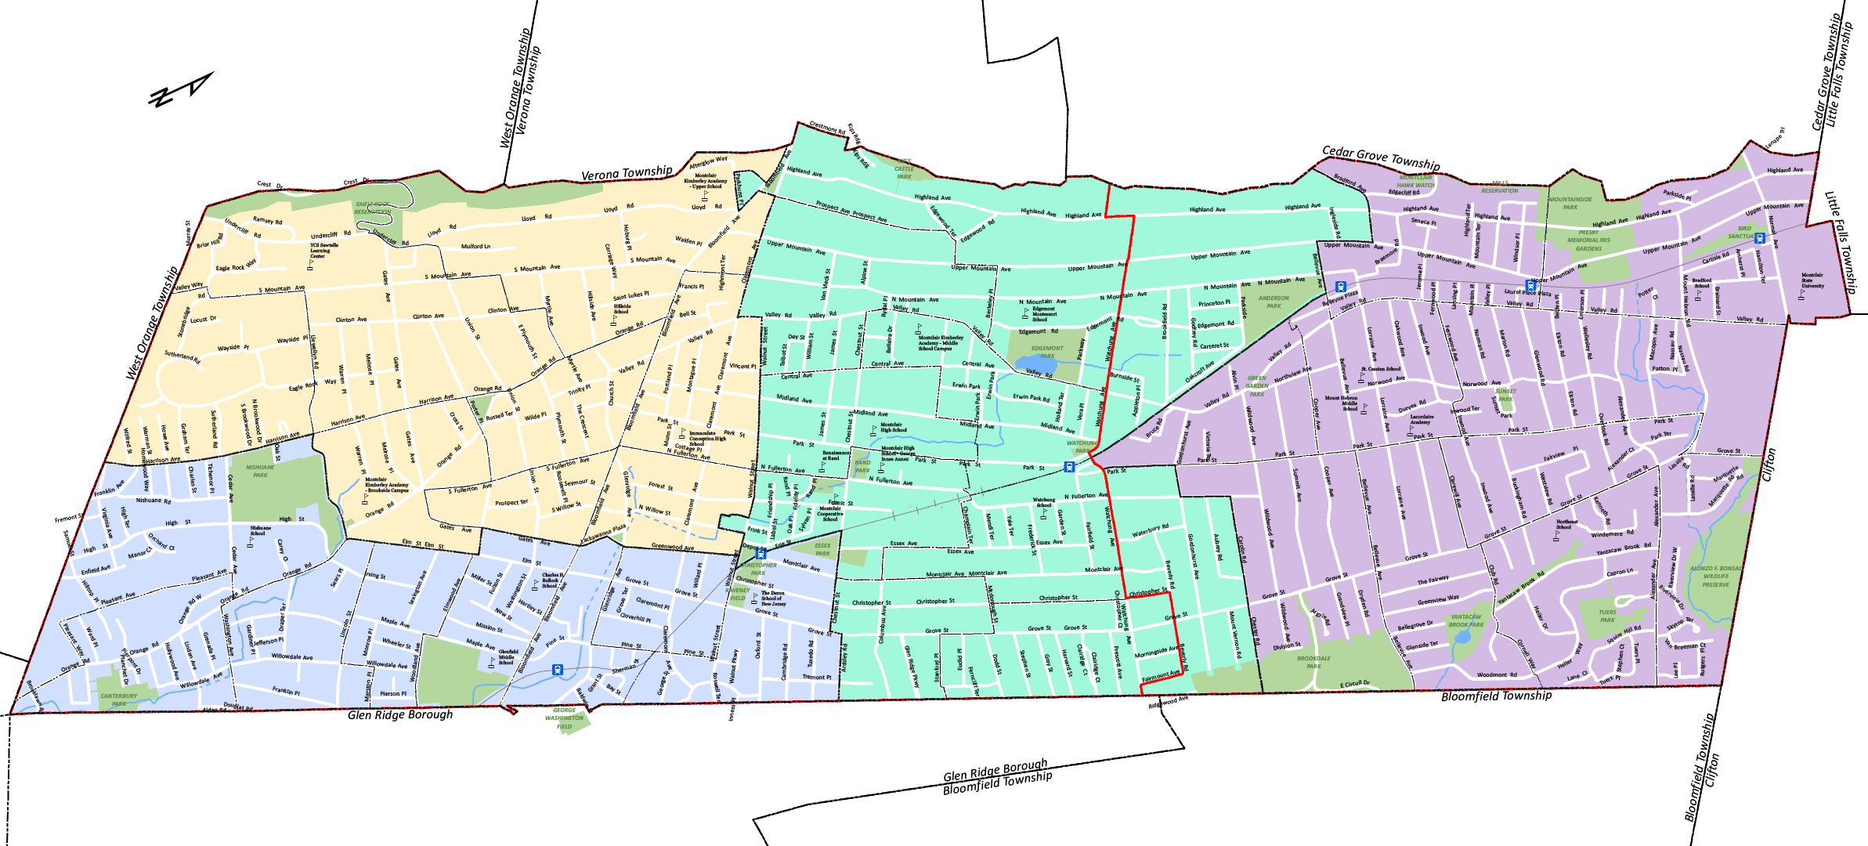
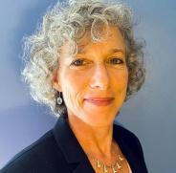
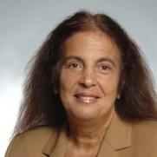
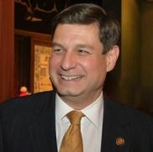
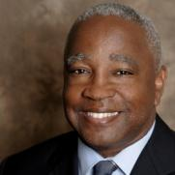

MONTCLAIR WARDS
Sean Spiller
Mayor
Peter Yacobellis
Councilor-
at-Large
Robert J. Russo
Councilor-
at-Large
WARD 3
WARD 2
Lori Price Abrams
Robin Schlager
WARD 1
Bill
Hurlock
Deputy Mayor
WARD 4
David Cummings

Slide 7
Quick YTD
MONTCLAIR
REVENUE
OVERVIEW

Slide 8
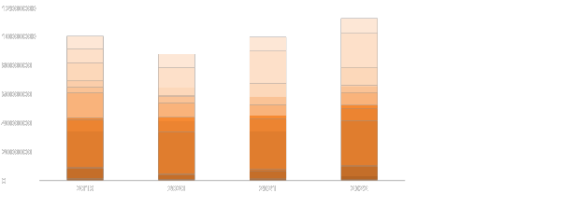
GENERAL
REVENUE
(As of September / Parking Revenues not included)
$11,264,883
$10,046,846
$9,979,862
Interlocal Services Agreements
$8,783,329
State Aid Revenues
Uniform Construction Code Fees
Interest on Investments
Interest and Costs on Taxes
Municipal Court Fines & Costs
Police & Fire Off Duty Fees
Other Misc. Anticipated Revenue
Payment In Lieu of Taxes
Fees & Permits - Vacant Properties
Fees & Permits
Other Licenses
Liquor Licenses

Slide 9

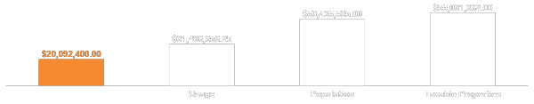
What should Glen Ridge have paid for
the use of Montclair’s Fire Department?
Missed opportunity on cumulative revenue to Montclair over 15 years
Alternate Proposals
New “Deal”
(5%)
By Usage
(10%)
By Population
(16%)
By Taxable Properties
(17%)
On Demand Costs
$61,111 yearly increases
3% yearly increases
Based upon no
published data
Based upon various
public budgetary metrics
*According to unpublished information provided by Montclair Fire Chief

Slide 10
Should payments be based on per incident costs or on the real costs of running and maintaining an entire department?
Should payments be based on per incident costs or on the value of the entire service?
Proposed Deal
(5%)
What are Glen Ridge residents paying to use
Montclair’s $17M fire services for the next 10-15 years?
GLEN RIDGE
7,000 residents
WHAT DO THEY RECEIVE?
MONTCLAIR
40,000 residents
YES
YES
YES
YES
YES
NO
240
State of the art Fire Department
76 Personnel
3 Fire Houses, 6 Trucks
24/7 on-call service
Inspections, hydrant flushing, etc.
A say in department governance
Avg # of calls/year
YES
YES
YES
YES
YES
YES
1,800
WHAT WILL THEY CONTRIBUTE TO UNDER NEW CONTRACT?
$247
YES
YES
NO
NO
NO
NO
Approximate cost per call
“Fuel, maintenance, depreciation”
Salaries while on a call
Total salaries, overtime, pensions
Insurance
Equipment replacement
Infrastructure, utilities
Cost for first year
$9,400
YES
YES
YES
YES
YES
YES
$850K
$16.1M

Slide 11
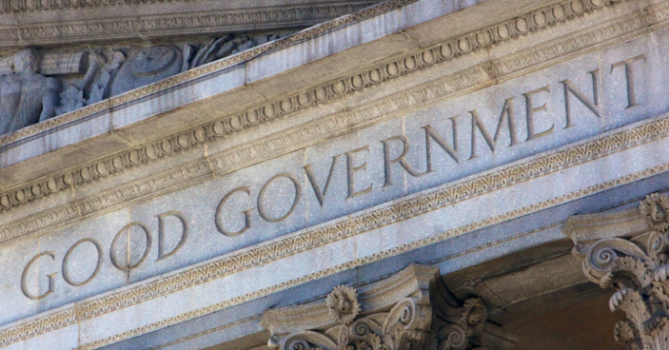
Good Government
My philosophy :
Taking a stance on issues
Communicating clearly
Using data to inform decisions without forgetting that people are policy
Sunlight is the best disinfectant
Supporting an independent press
Encouraging active public engagement

Slide 12
TOWNSHIP
PROJECT
UPDATES

Slide 13
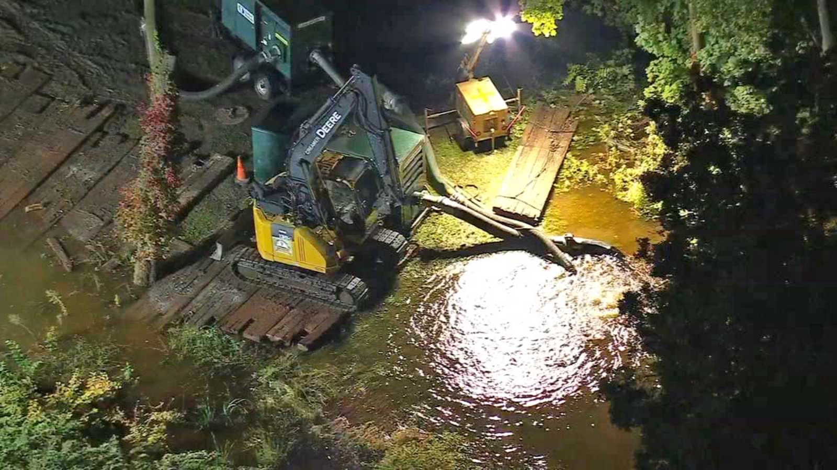
Water Main Update (as of Weds. Oct. 19th 2022)
Thank you to our Montclair Water Bureau, Fire Department, Police and Community Services teams
We are in the process of switching back to our normal supplier
The State of Emergency is still in effect
Conservation still necessary
Hope to be in good shape by the weekend

Slide 14
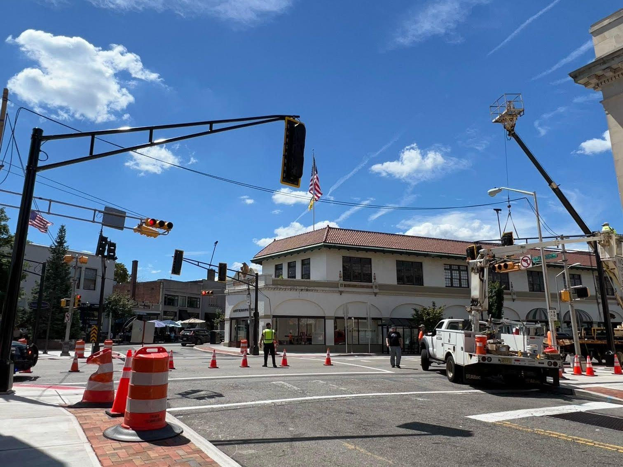
Bloomfield Ave Traffic Signals
Thank you to Essex County for making this investment in Montclair!
I’m working with Commissioner Brendan Gill and his team on the timing of the lights with the feedback that has been received

Slide 15
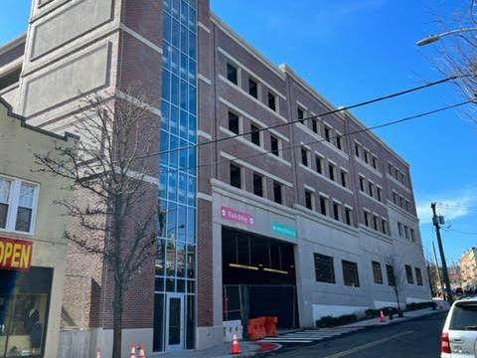
Parking Deck Update
ADA Compliance Updates - Projected Completion Date of Nov. 9th
Re-inspection immediately to follow in November
Barring unforeseen circumstances, it should be open for holiday shopping season

Slide 16
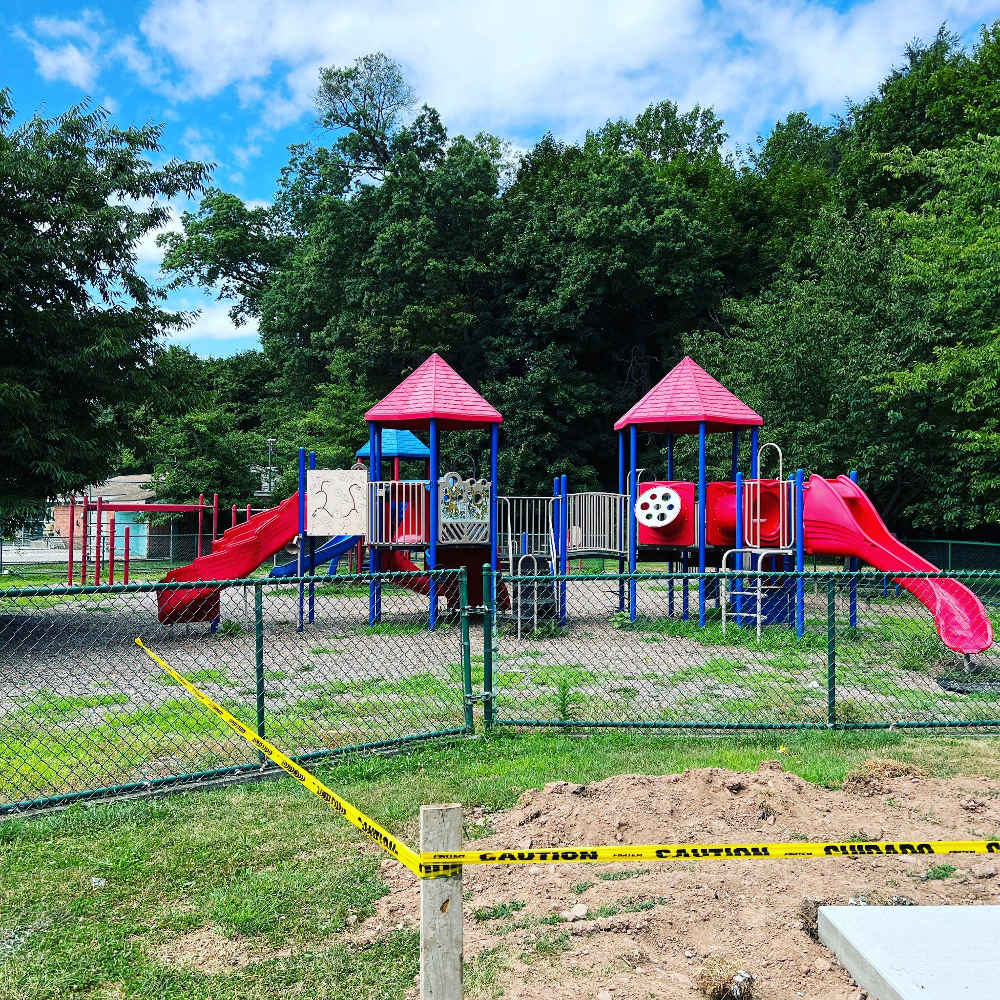
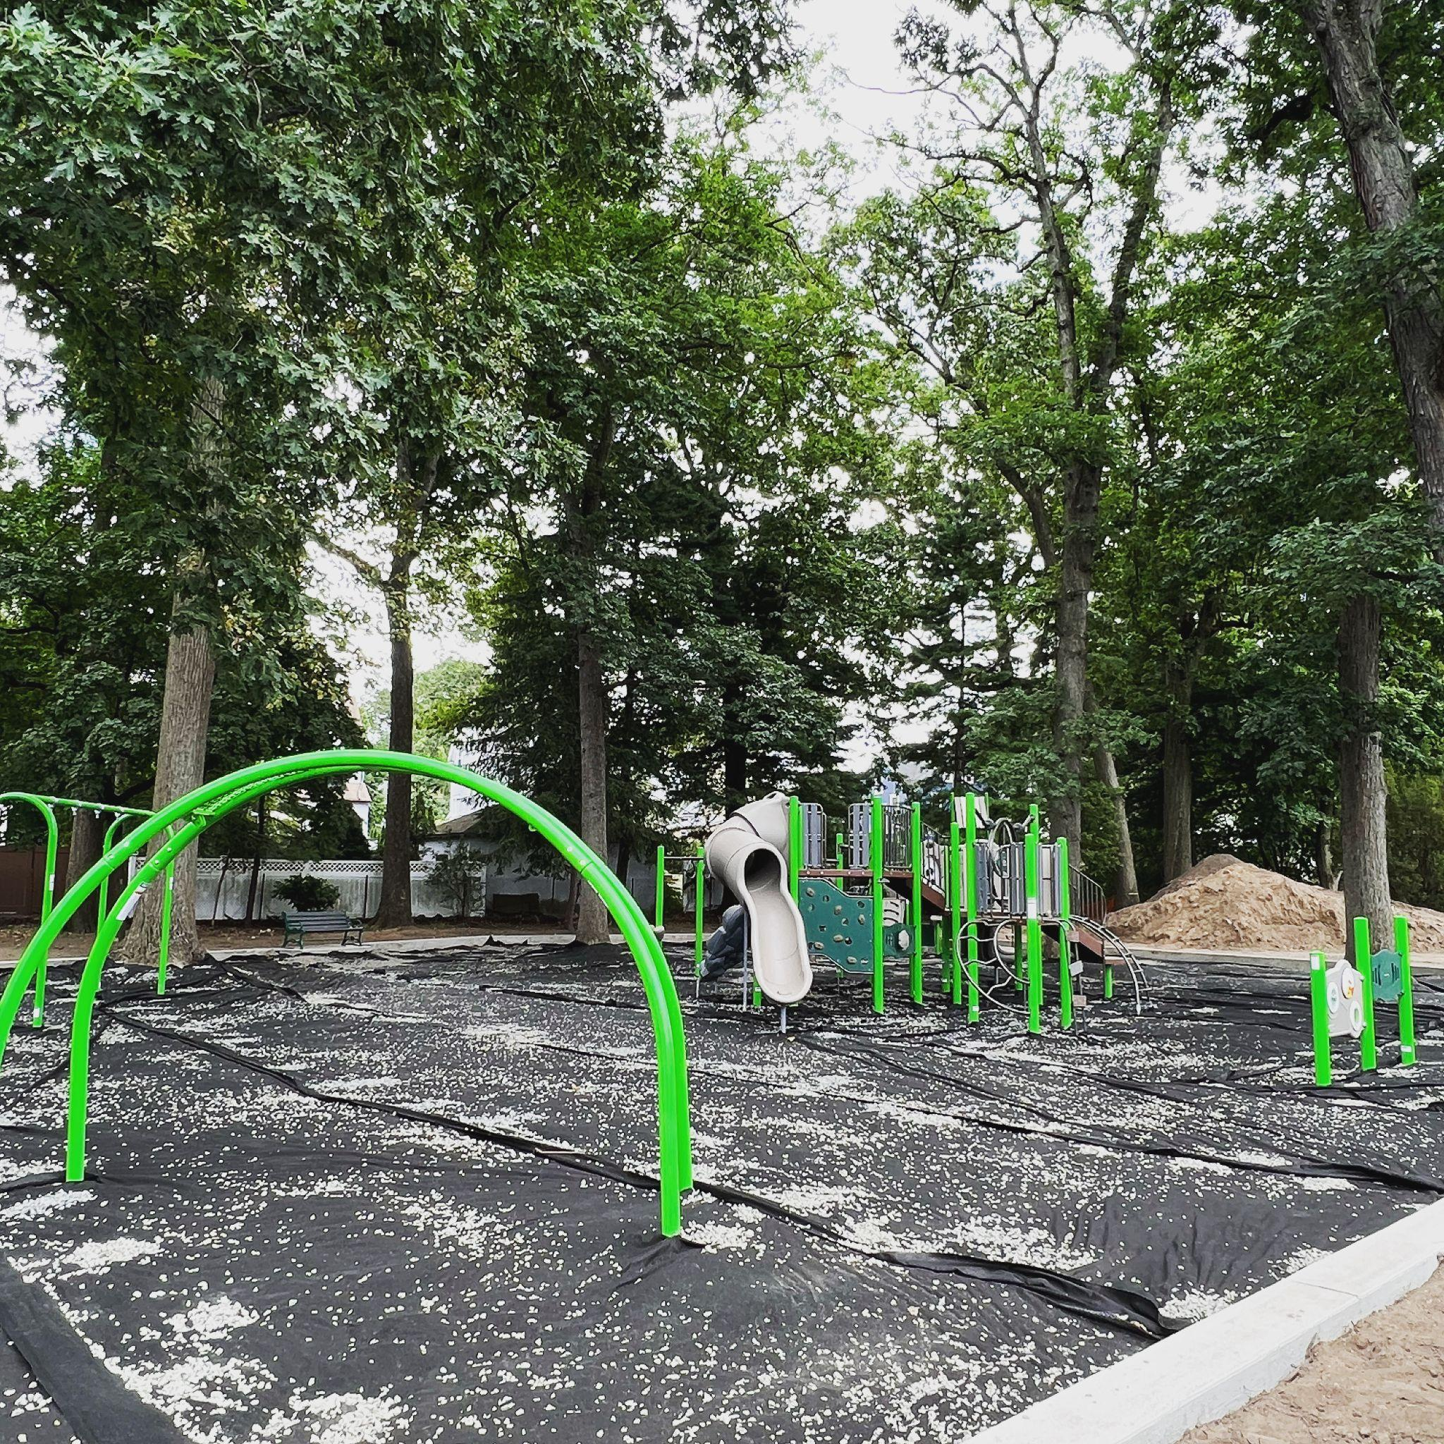
Parks Update
Park updates to be completed by the end of October barring any unforeseen circumstances or extended periods of inclement weather.
Pools to reopen in 2023.
Need to think about capital improvements to pools going forward.
Nishuane Park (Above)
Essex Park

Slide 17

Cannabis
Ascend has been approved and is open for recreational sales
Town received 7 applications for 2 remaining retail licenses
(hope to approve by year end)
We have also received applications for cultivators and manufacturers

Slide 18
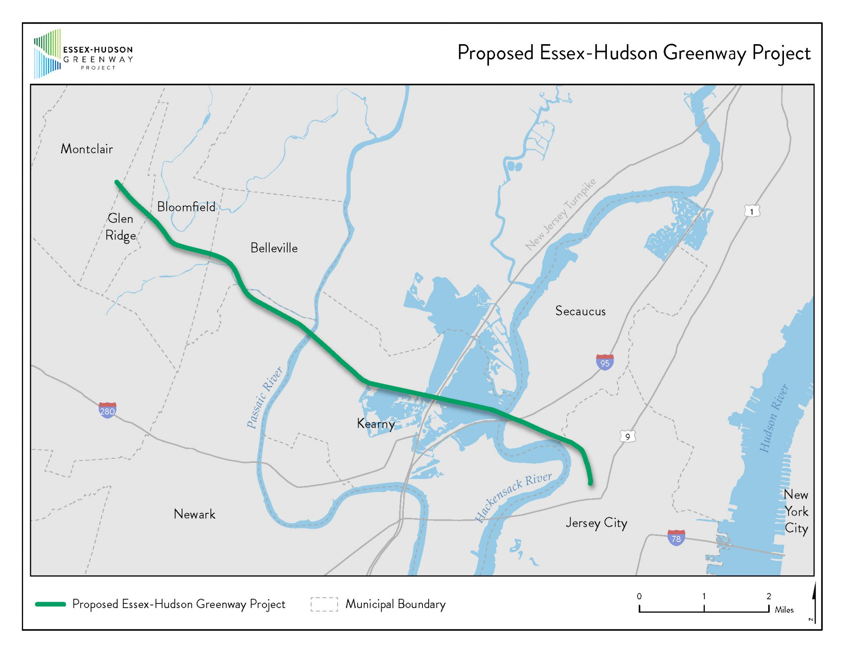
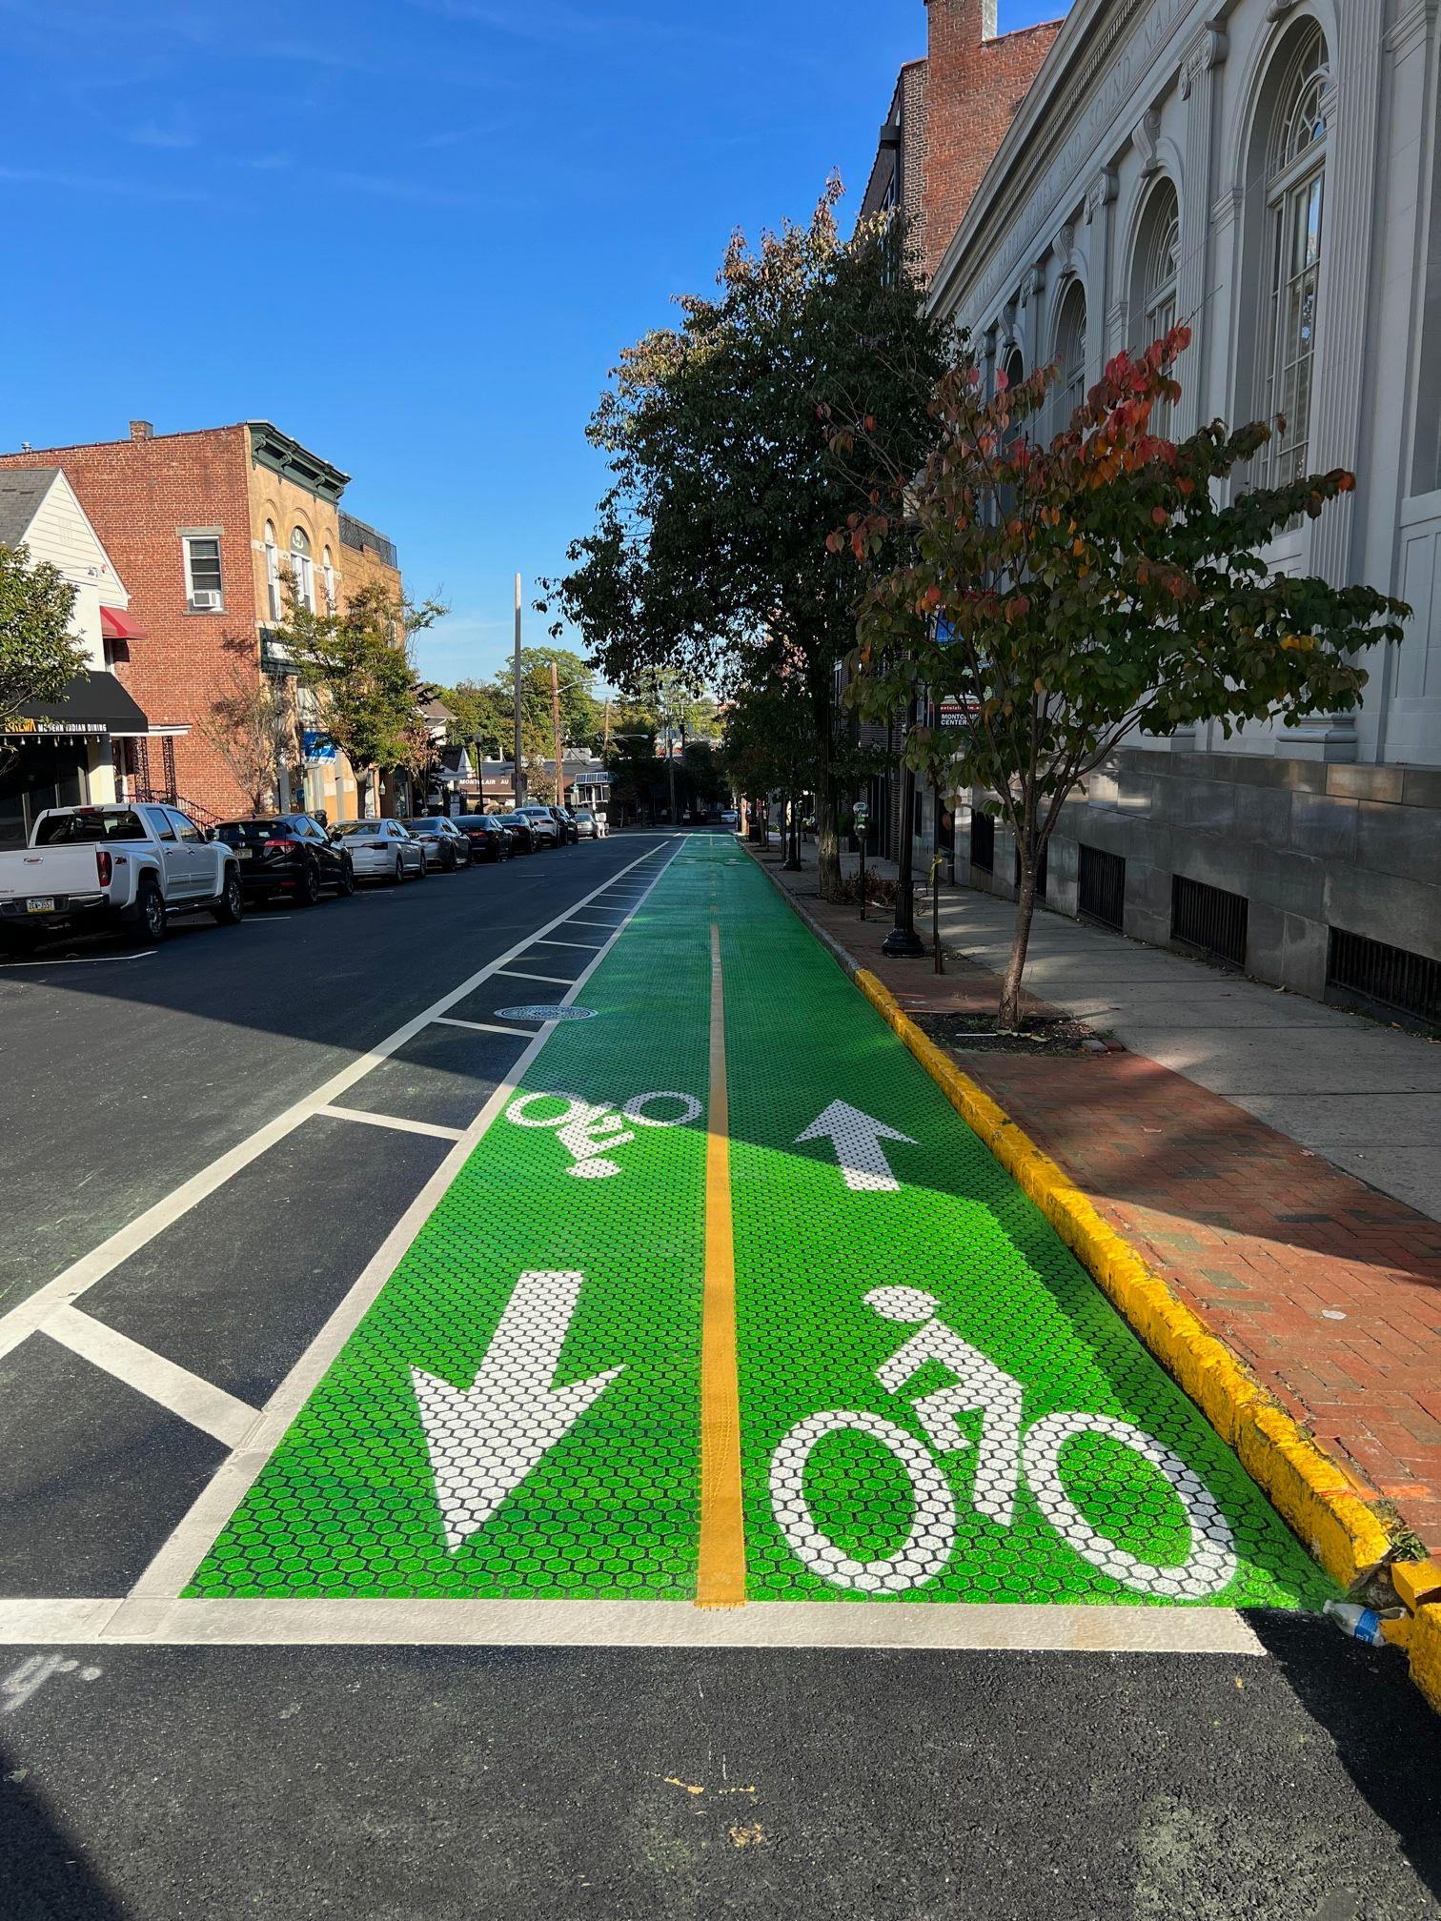
Bike Lane to Nowhere?
Land has been acquired for the Essex Hudson Greenway, beginning near Bay St.
This is the first leg of "Downtown Connection" to Greenway
Grant-Funded
Happening in phases over several years, phase 2 grant being pursued
*Glenridge ave (above)

Slide 19
UNDERSTANDING
MONTCLAIR’S
SCHOOL BOND

Slide 20
BEFORE & AFTER

Slide 21
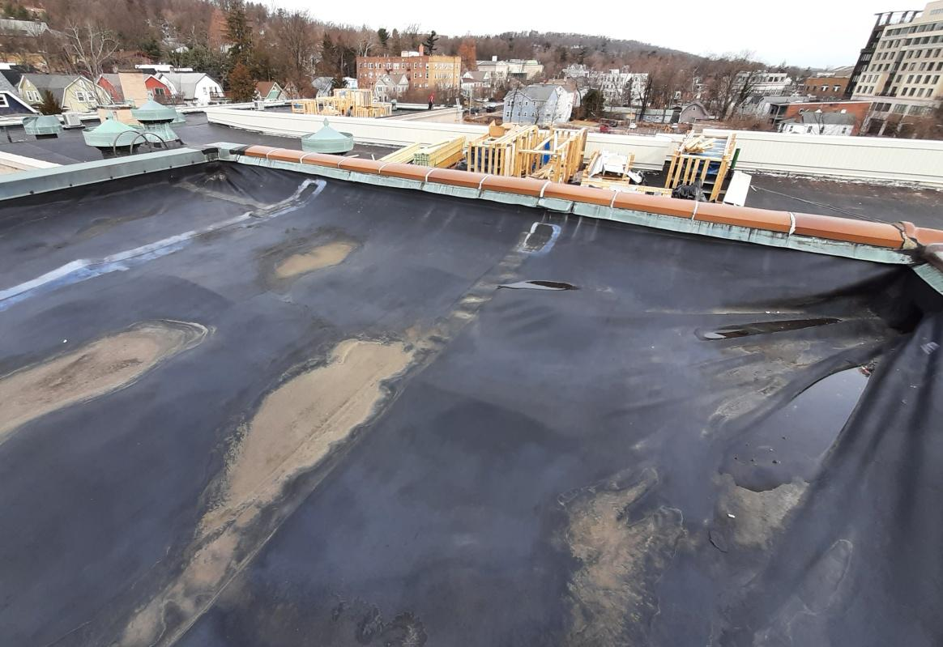
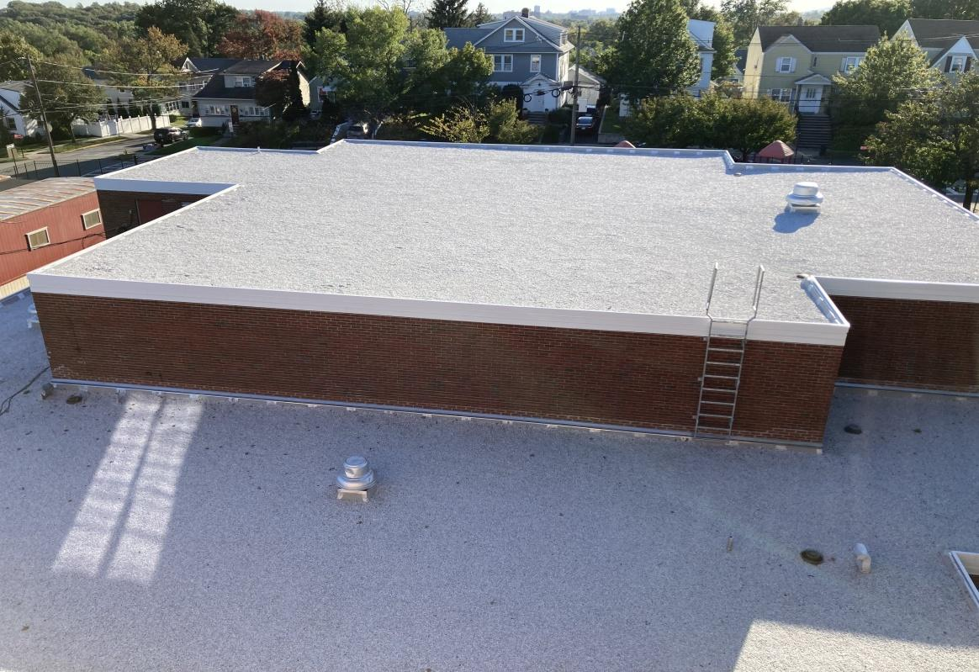
HILLSIDE
Hillside Roof (2022)
Hillside Roof (Rendering)

Slide 22
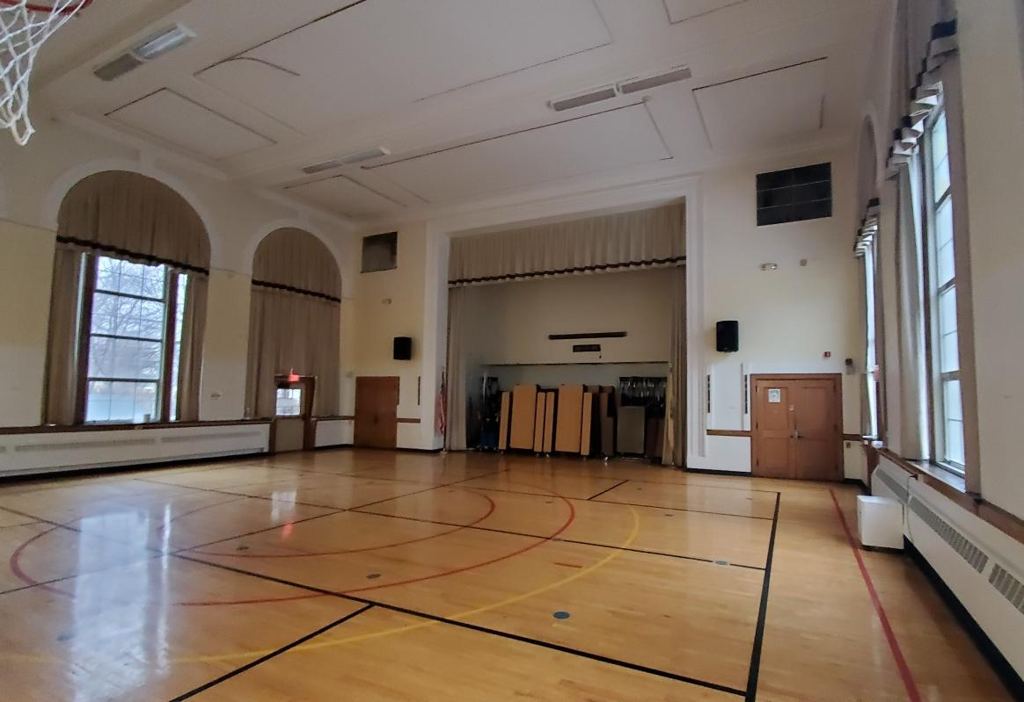
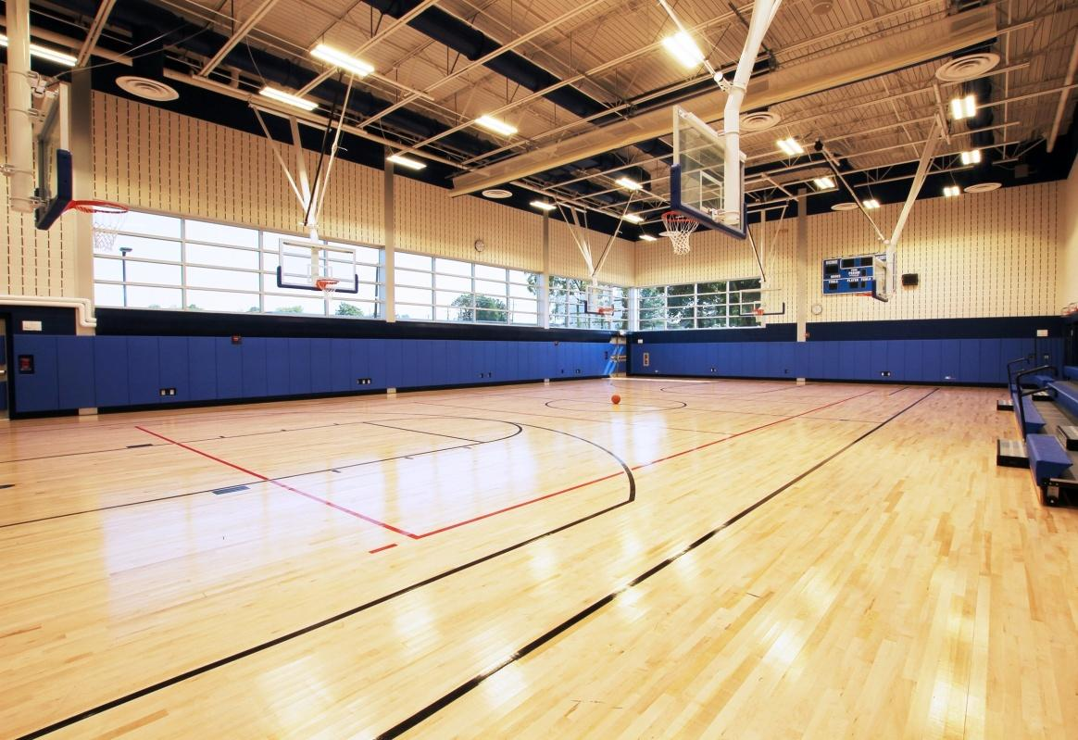
RENAISSANCE
Renaissance Gymnasium (2022)
Renaissance Gymnasium (Rendering)

Slide 23
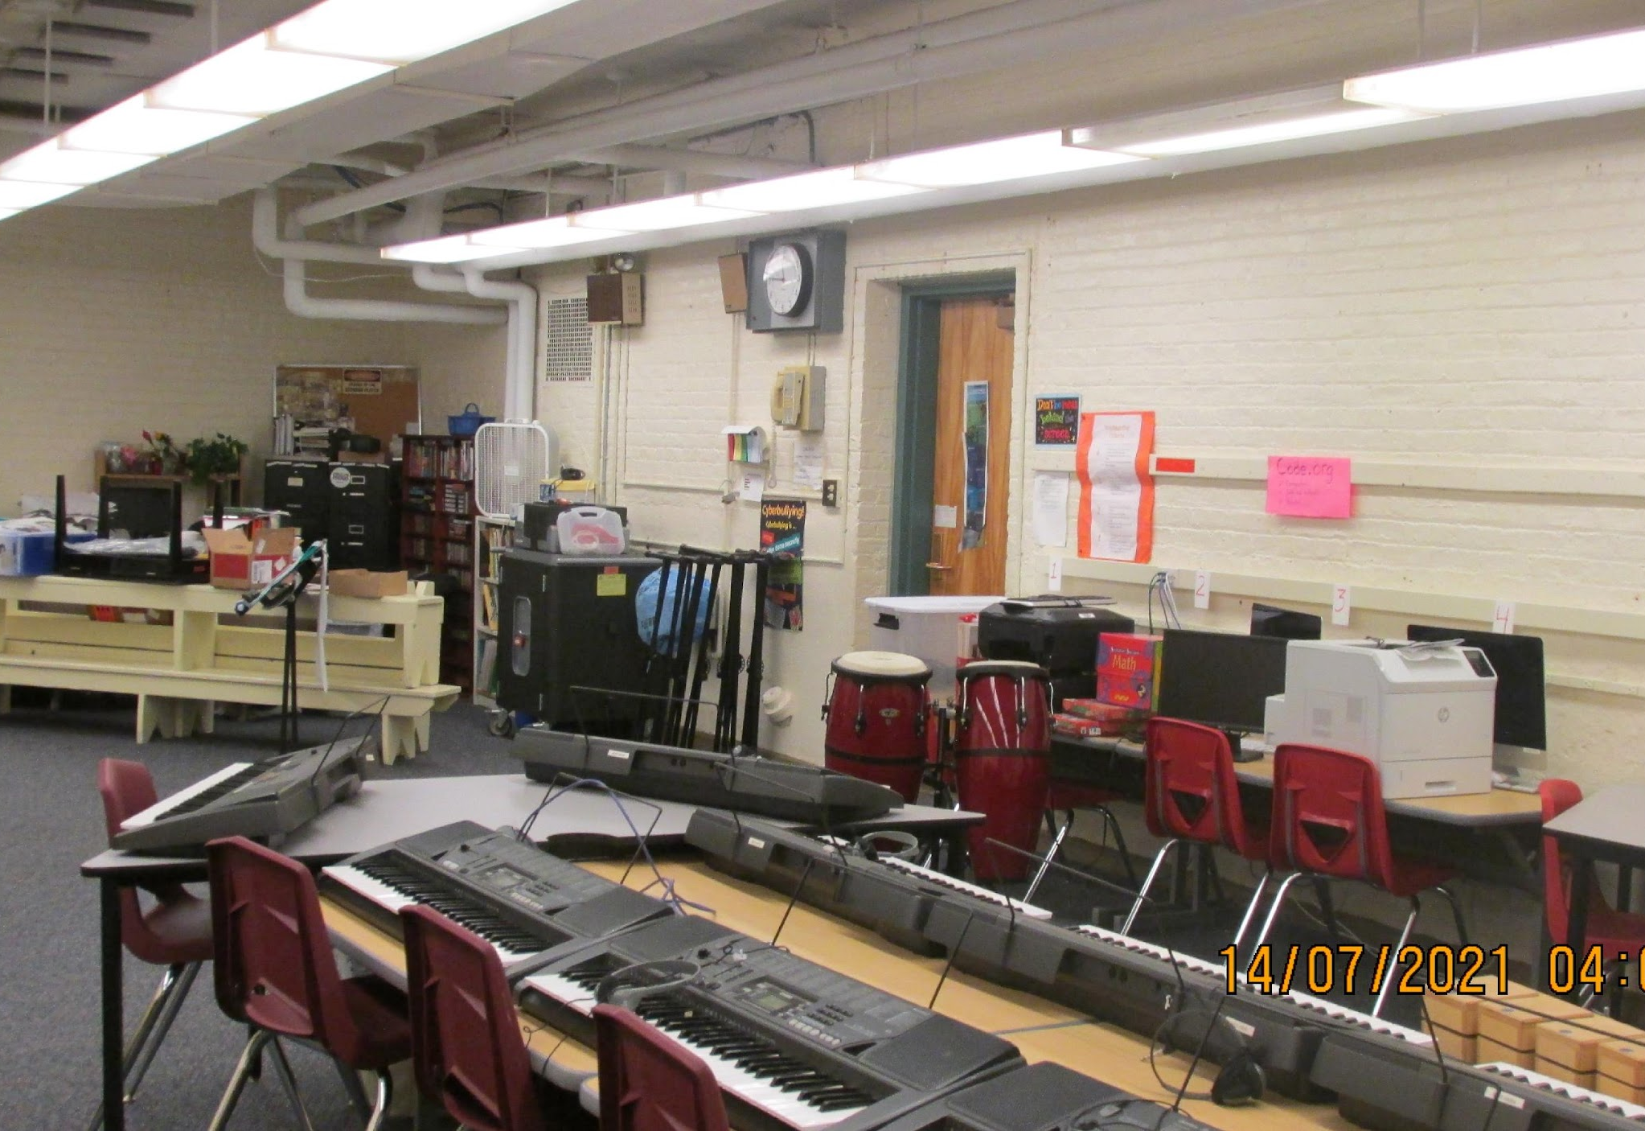
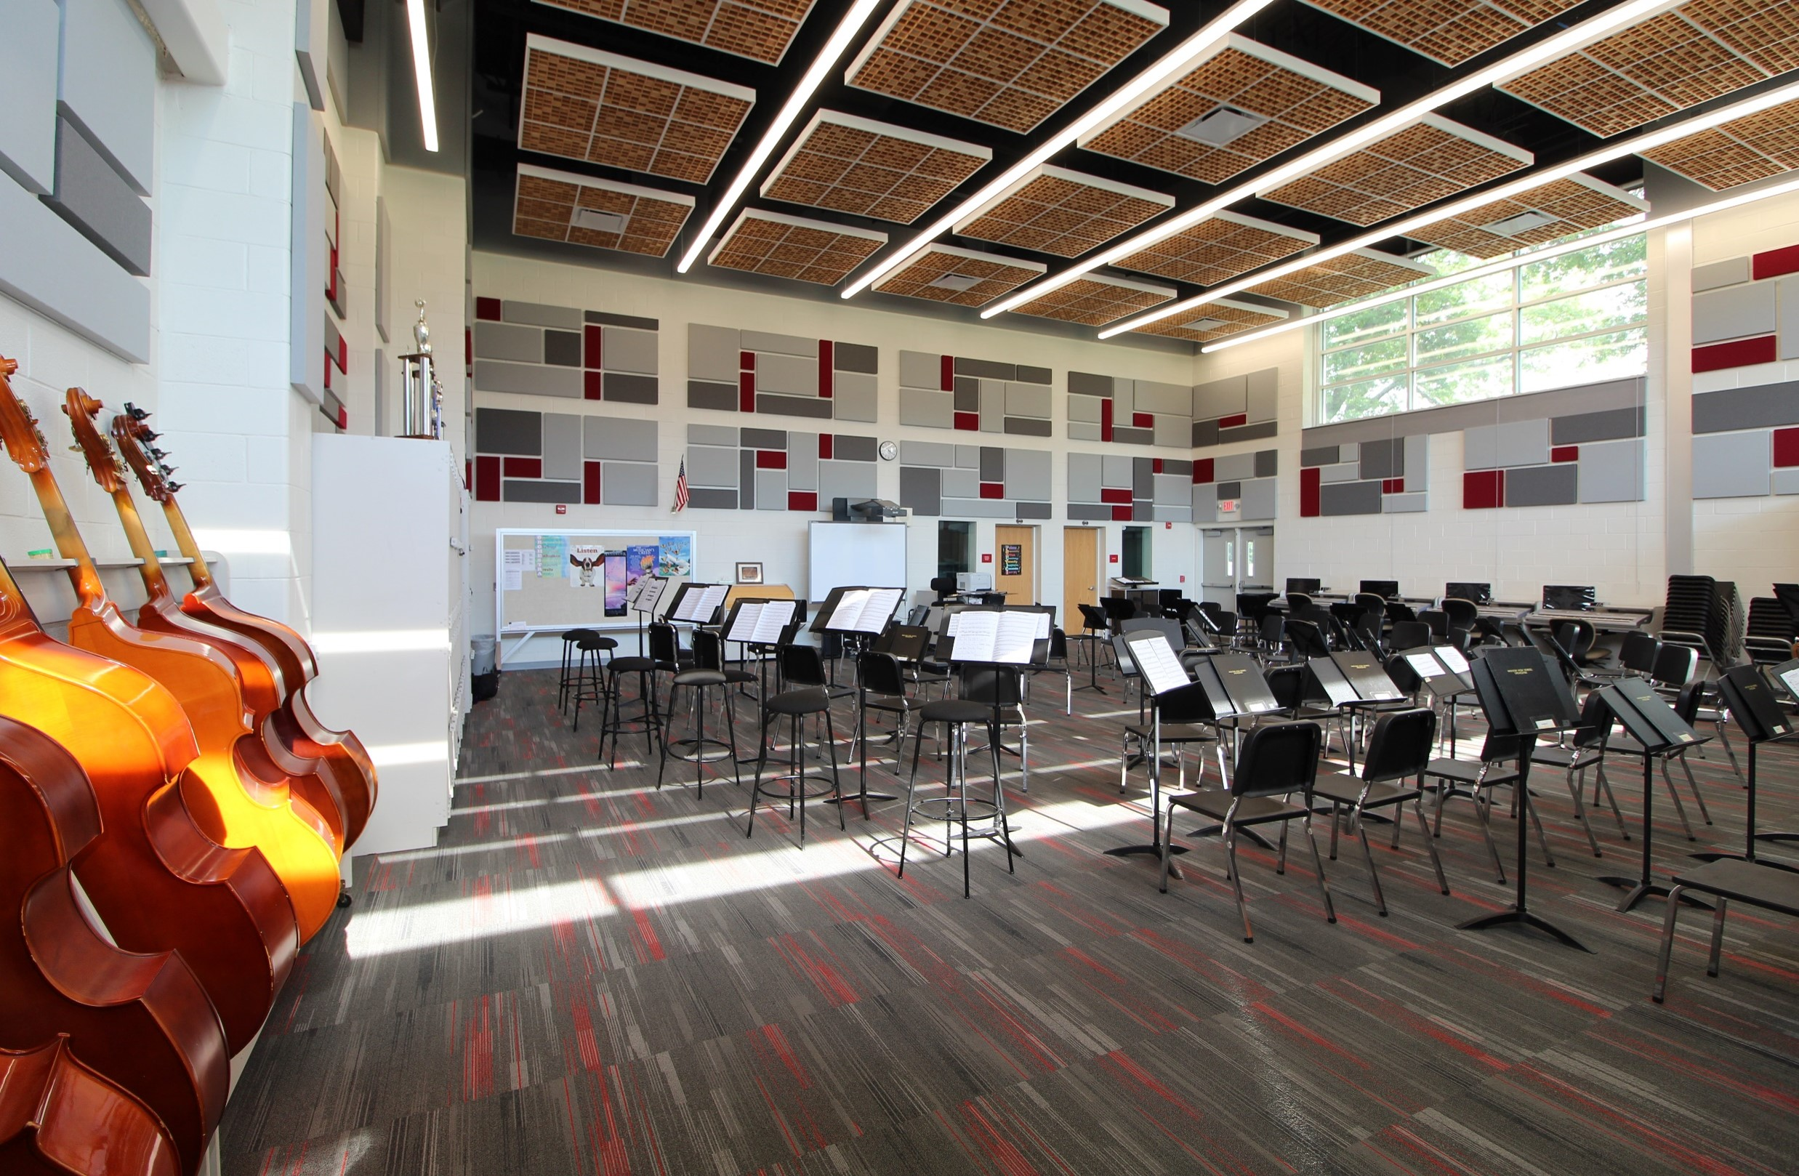
NISHUANE
Nishuane Music Room (2022)
Nishuane Music Room (Rendering)

Slide 24
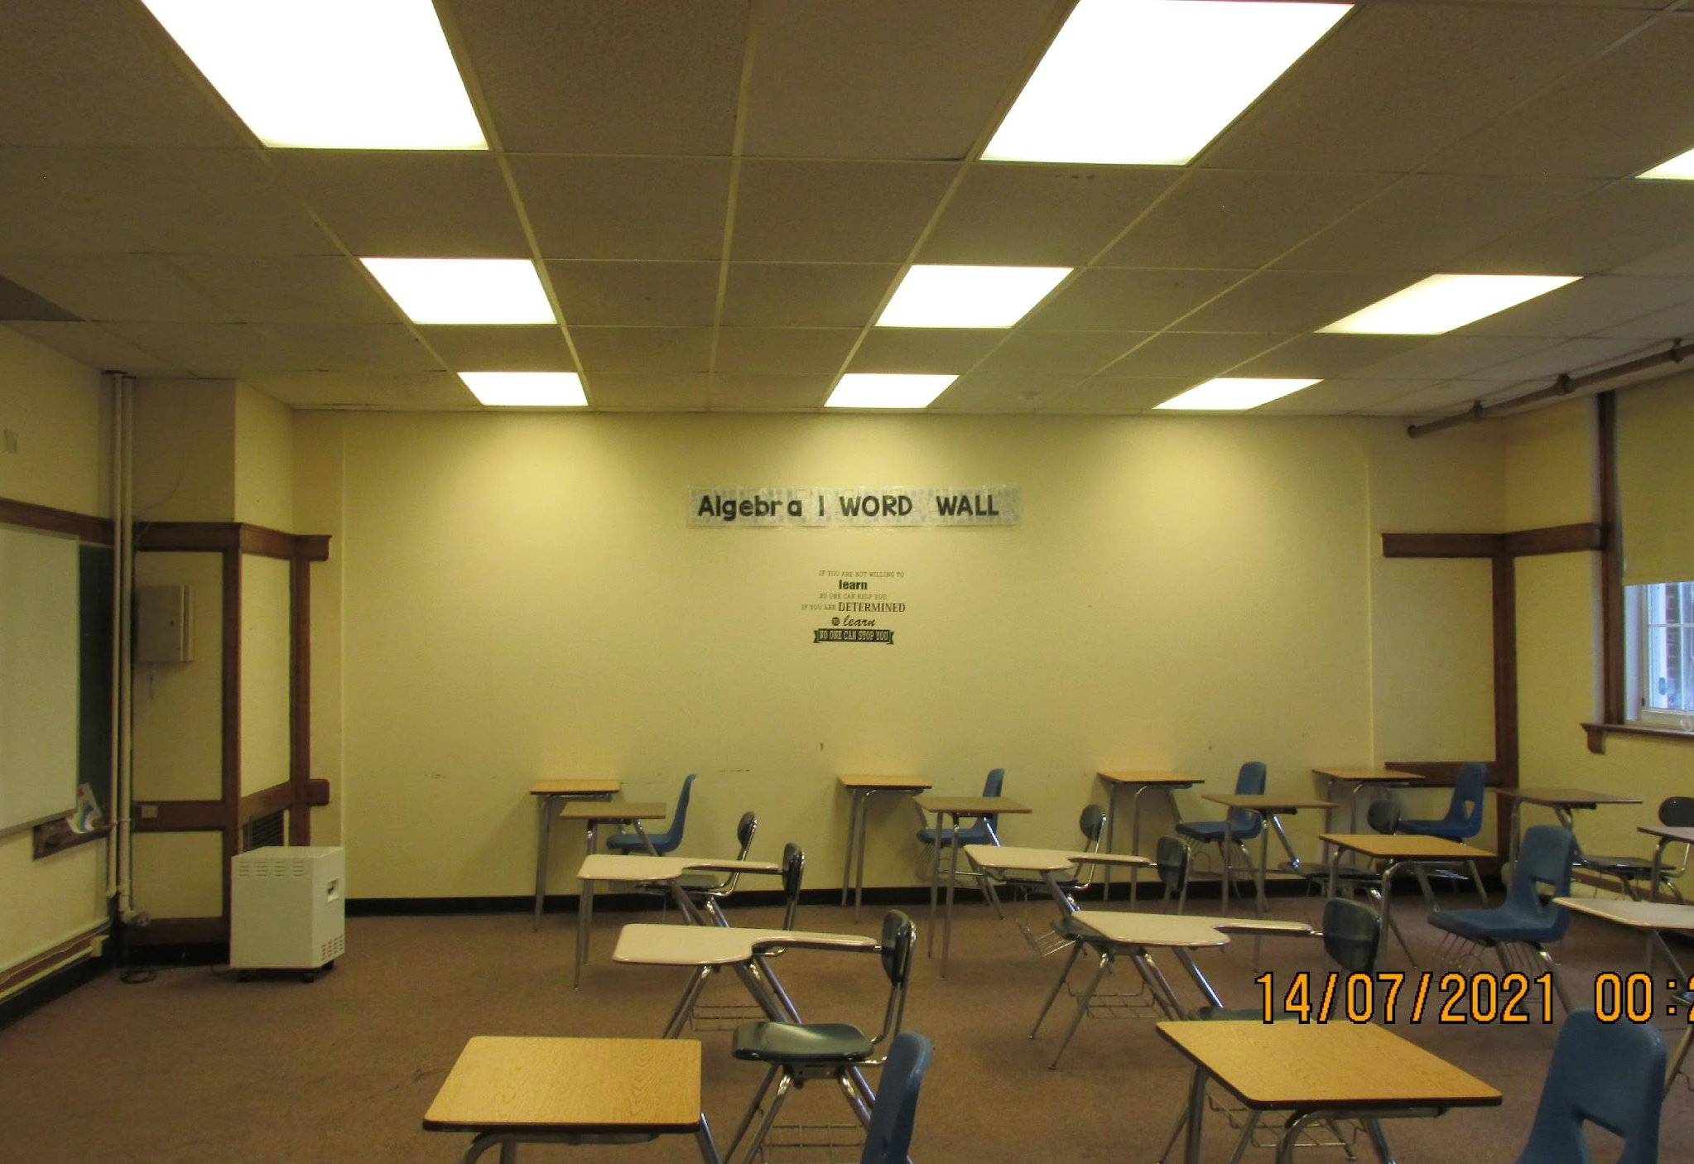
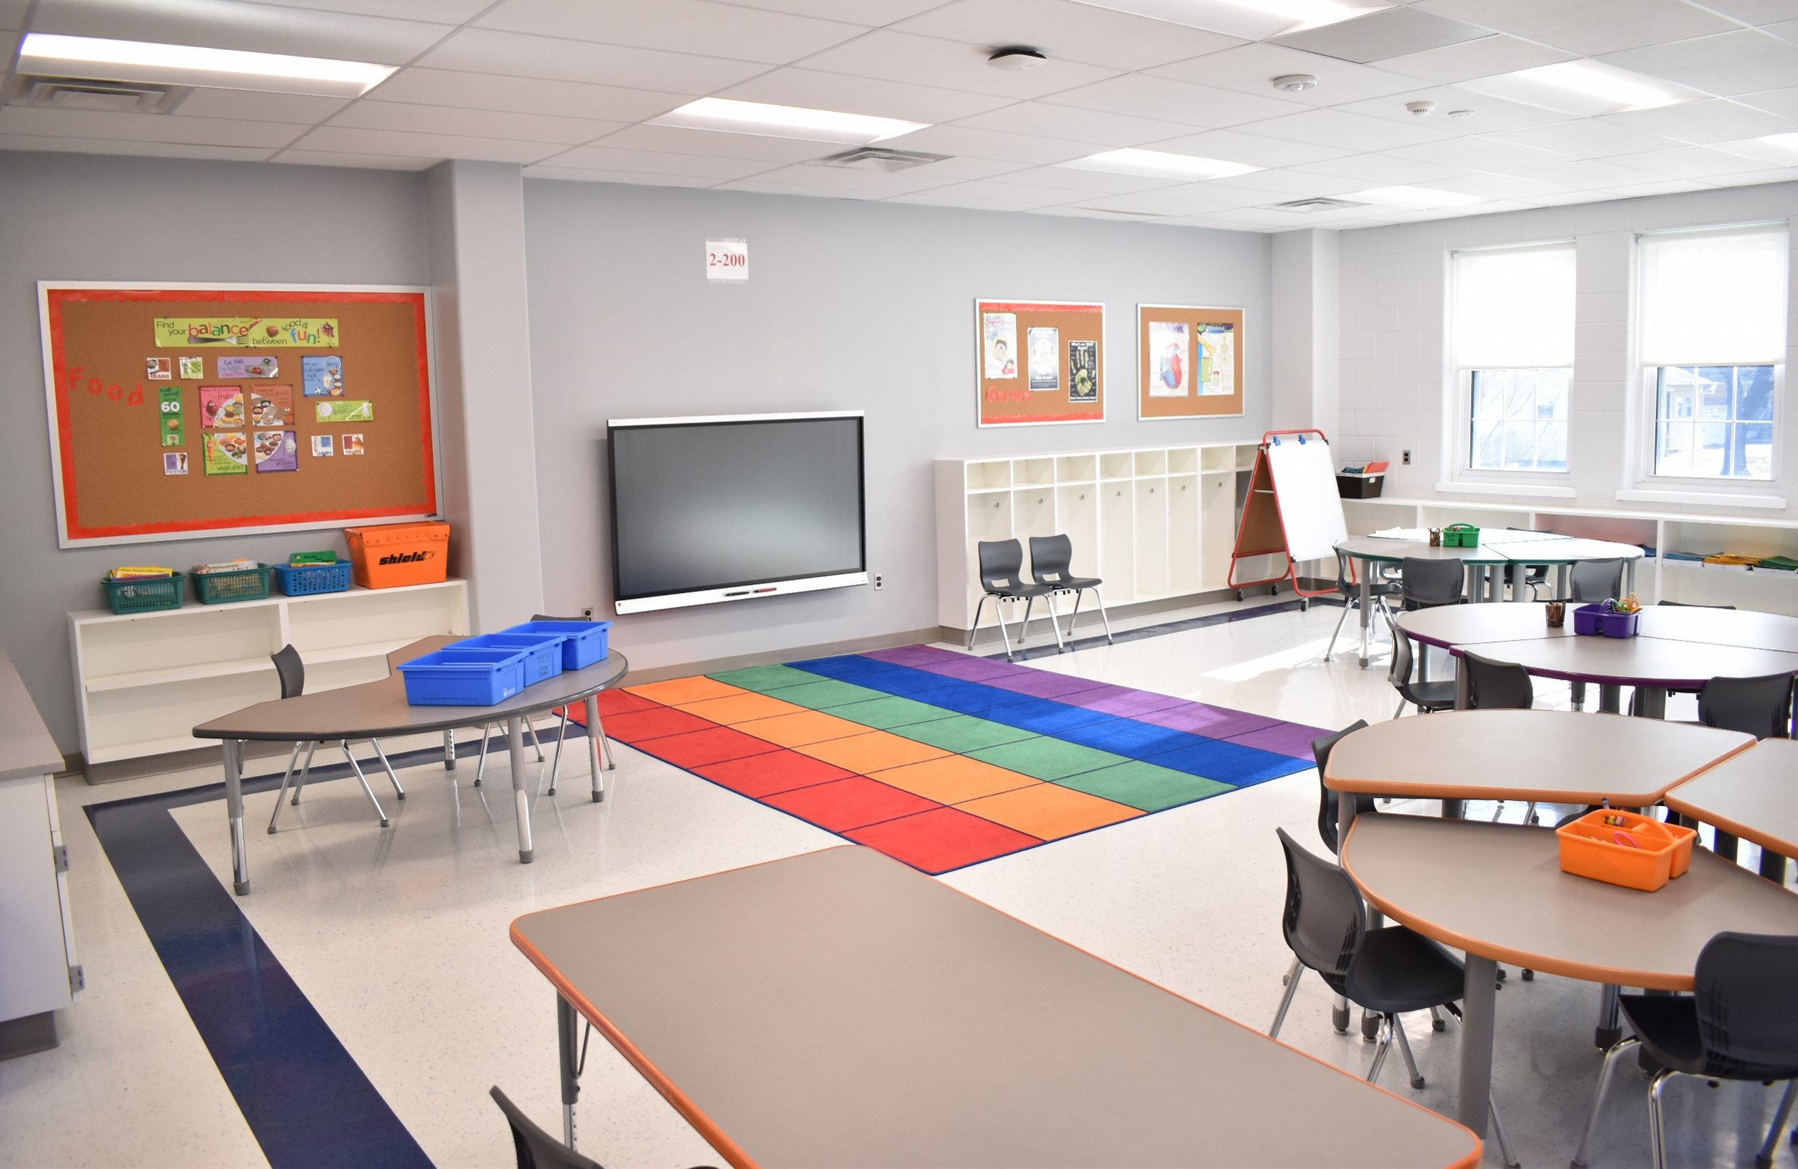
GEORGE INNESS
George Innes Classroom (2022)
George Innes Classroom (Rendering)

Slide 25
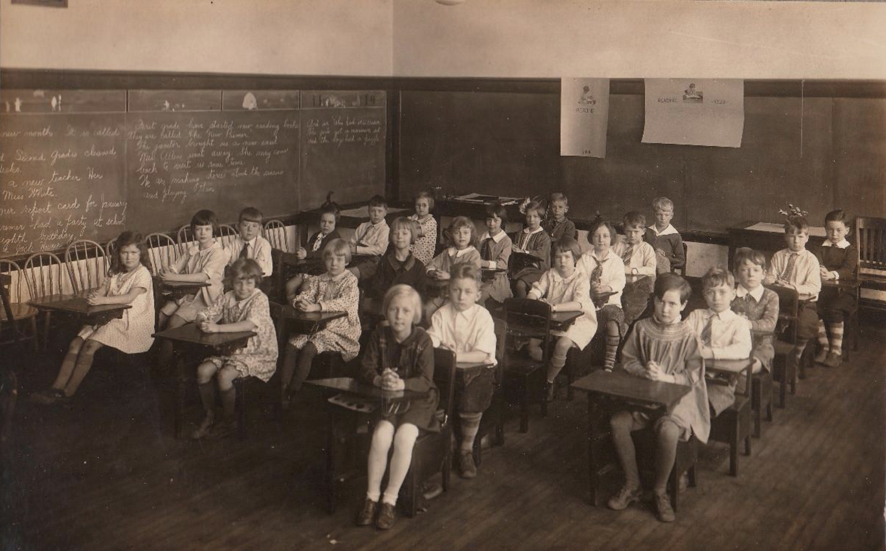

AN AGING SHOOL
INFRASTRUCTURE
The Average Age of a Montclair School is
96 years…
6 Schools
are over a century old!
Hillside
Only school
with Central A/C
Glenfield
Pre-K
Bullock
Buzz
Aldrin
Northeast
Bradford
Watchung
1907
1914
1924
1927
???
1900
1909
1909
1921
1926
1936
2010
MHS
Edgemont
George
Innes
Nishuane
Woodman
Field
$11M
Rand
Watchung School
Pre-K
$3M
1890
1900
1910
1920
1930
1940
1940
1950
1960
1970
1980
1990
2000
2010
2020

Slide 26
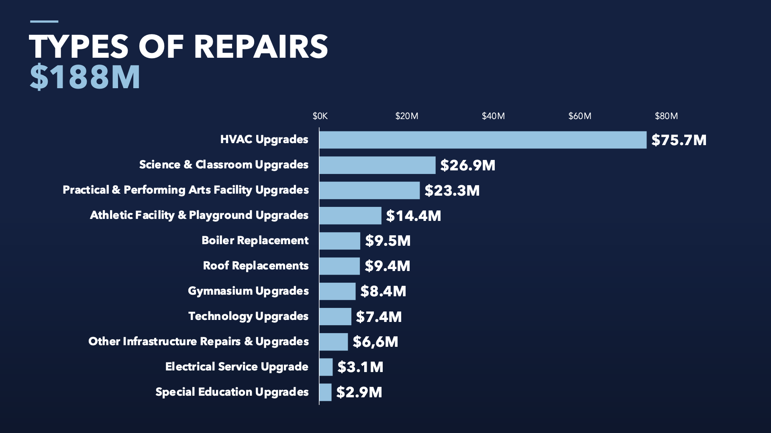
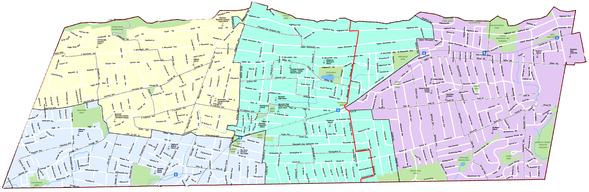
BY SCHOOL
$188M
Hillside
$25M
MHS
$49M
Bradford
$6M
Admin
Pre-K
$3M
Edgemont
$6M
Buzz Aldrin
$13M
Renaissance
$15M
George
Innes
$9M
Woodman
Field
$11M
Watchung
$4M
Nishuane
$13M
Northeast
$6M
Bullock
Glenfield
$25M
MHS
Hillside
Glenfield
Renaissance
Nishuane
Buzz Aldrin
George Innes
Bradford
Edgemont
Northeast
Watchung
Montclair Pre-K
Bullock
Woodman Field
Admin Bldg

Slide 27
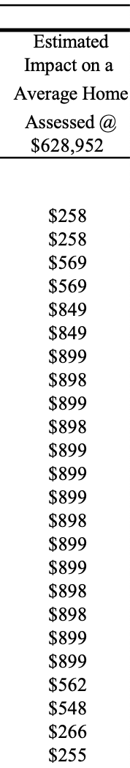
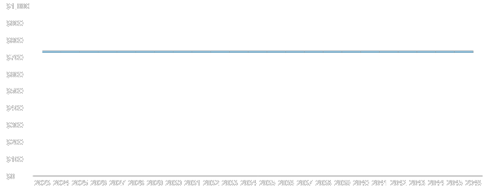
TAX
IMPACT
Studies show similar bonds increased property values 6%
Annual average tax impact per year is $732 over 24 years* or just $2 a day
Avg tax impact starts
at $258/yr in 2023*
*Based upon a town home assessment of $627K

Slide 28

ATYPICAL
STATE SUPPORT
Typical reimbursement nationally is only 22%
The State will contribute 31% to total costs, an offer that may not be available in the future
31%

Slide 29
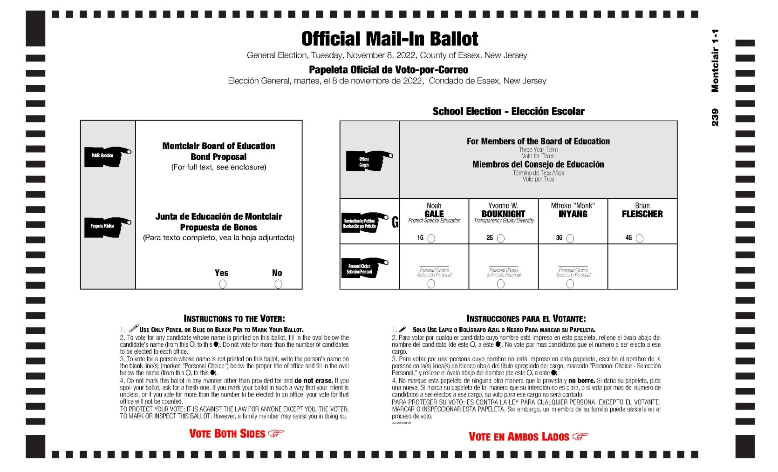
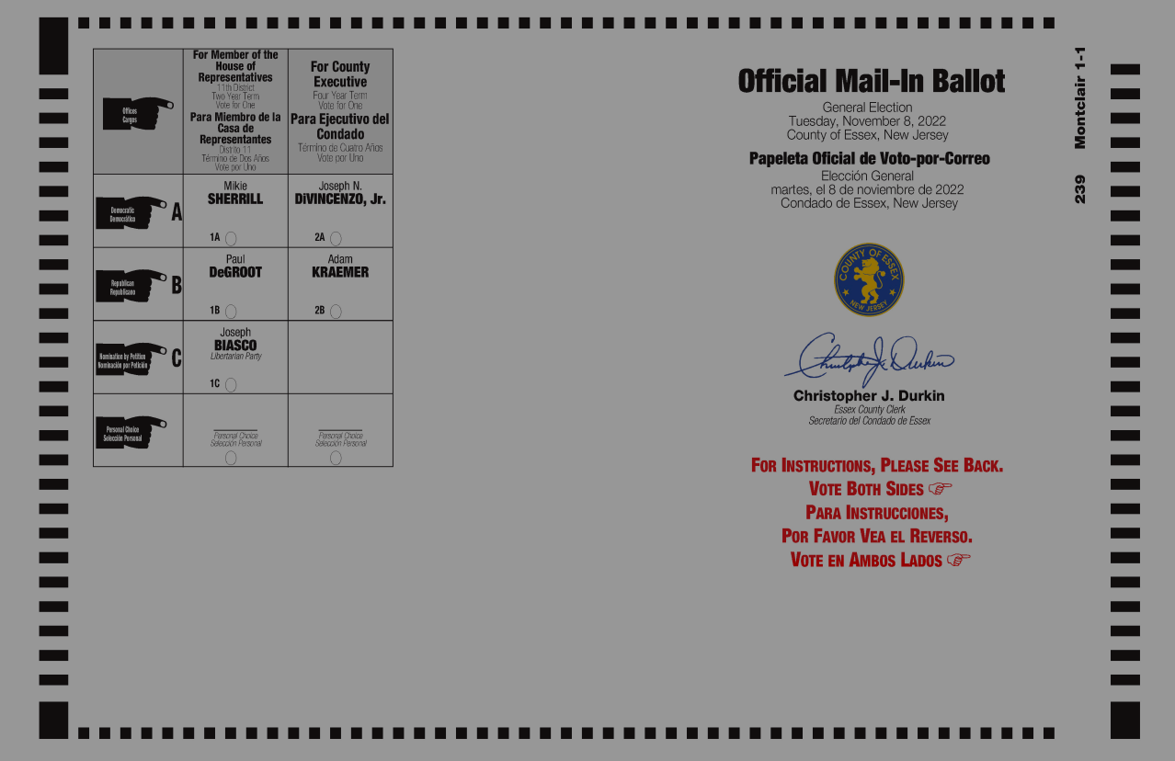
MAIL-IN
BALLOT

Slide 30


Slide 31
YACOBELLIS
TAKES A
STANCE

Slide 32
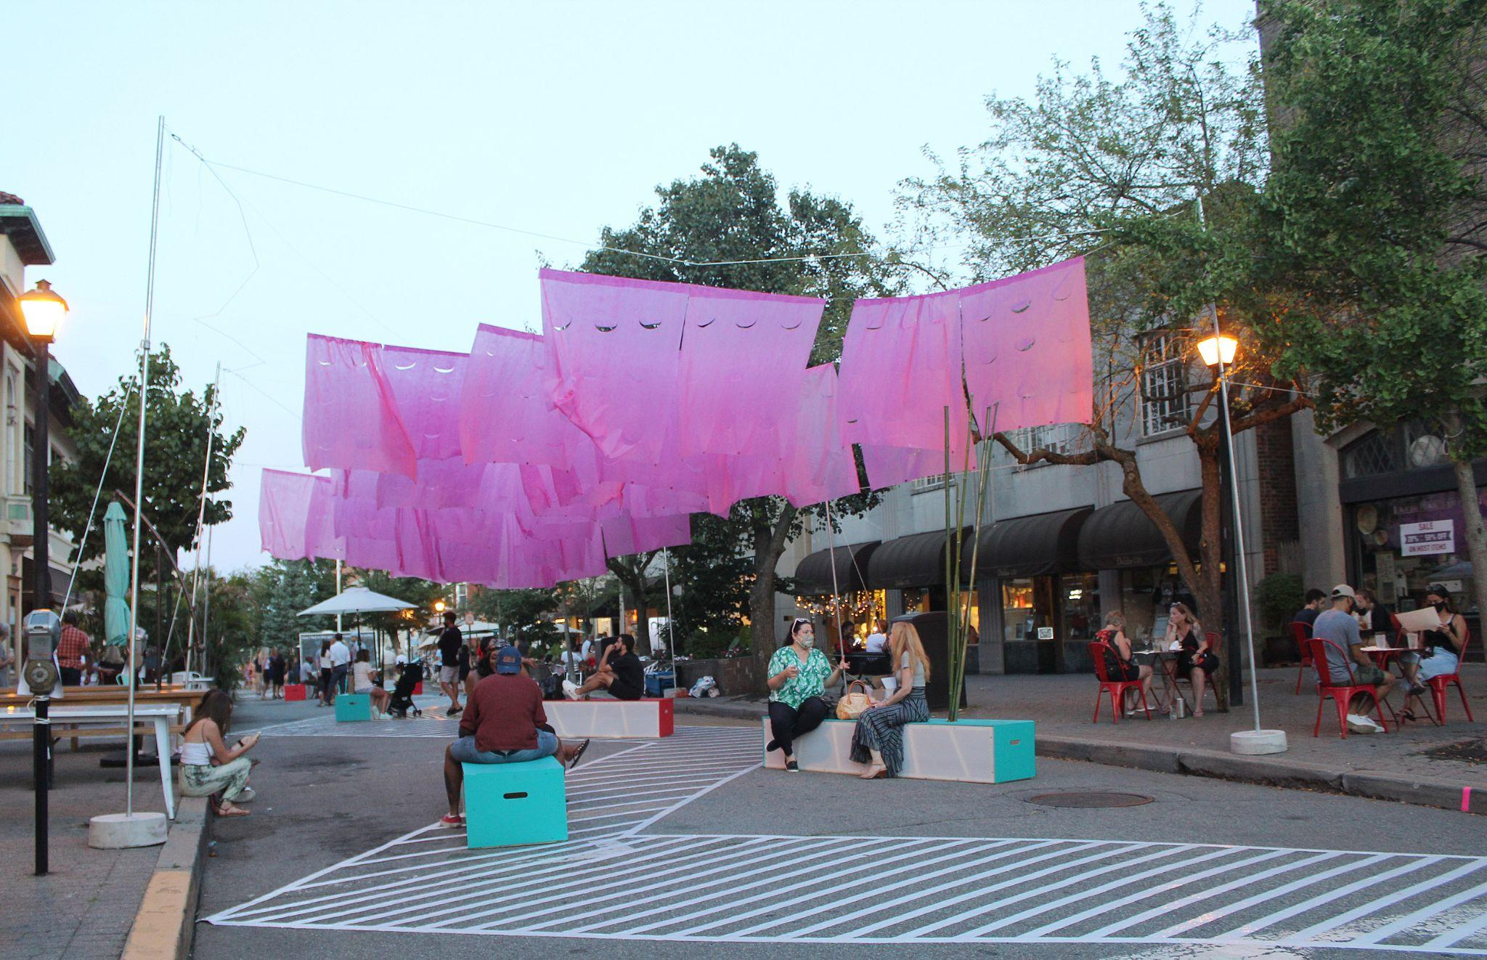
Church Street as a Pedestrian Plaza
Achievable
Need to balance street use needs for pick up and delivery services
Design with Emergency Services access

Slide 33
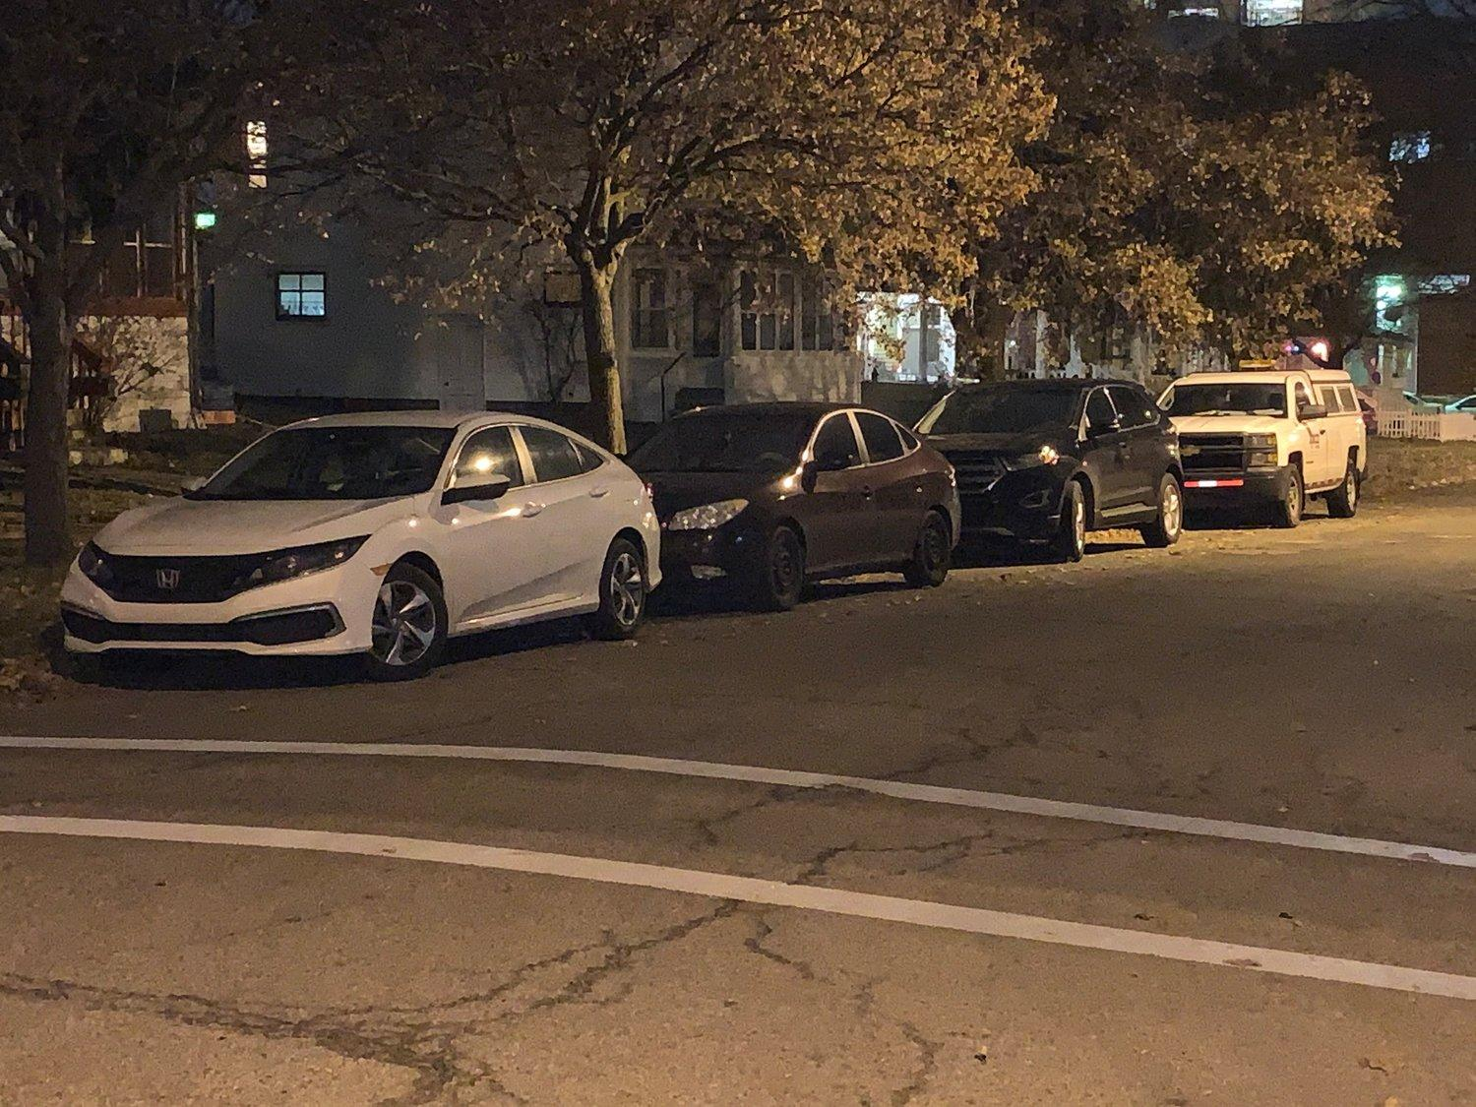
Should we revisit overnight parking?
Let’s lift the blanket ban and approach this street by street, starting with our most dense residential areas, issuing resident parking decals.

Slide 34
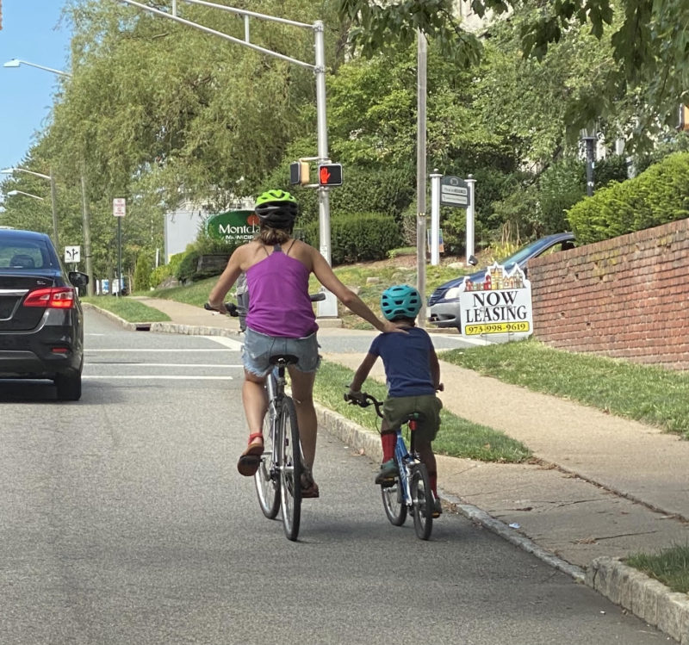
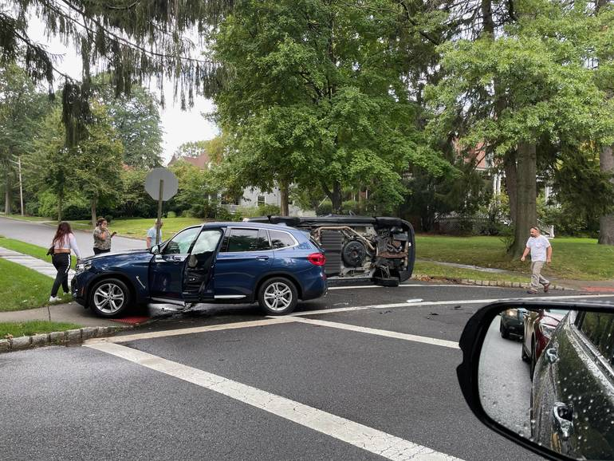
Safer Streets
Speeding & Reckless Driving is an Epidemic
We need more stern enforcement of the law
  Focus more on reckless driving than parking tickets
80+ Traffic Studies Requested by Residents
Working with the County to get digital speed limit signs placed on major thoroughfares
Create a rotary at Watchung Plaza
Institute Safe Complete Streets with Bump-Outs, Speed Bumps, Safer Crossings and simple bike/scooter lanes

Slide 35
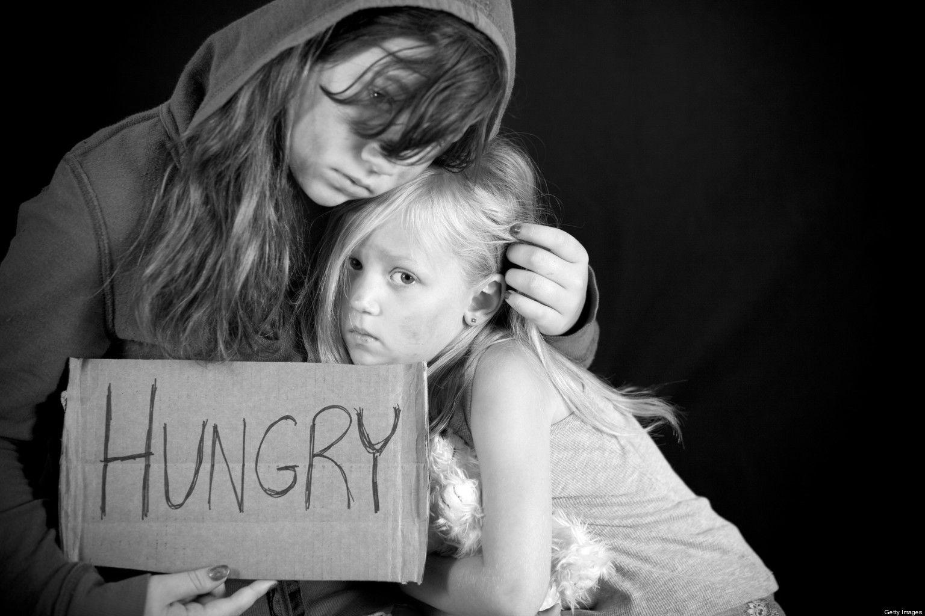
Ending Childhood Hunger In Montclair
Eliminating Childhood Hunger in Montclair is Achievable in the Near Term
Montclair has one of the bigges wealth gaps in America
Free Student Lunches in Montclair Public Schools are a big help
Toni's Kitchen Service Expansion helps
Free Little Food Pantries help
Additional Funding for After School Program Meals is needed
Support for Montclair Mutual Aid helps

Slide 36


Senior Services
We need a philosophical and budgetary shift to more human services in Montclair
Improve Communication and
Program Awareness to Seniors (use mail)
Fund a Needs Assessment. Last one was done in 2013.
Openly discuss Senior Community Center Options

Slide 37
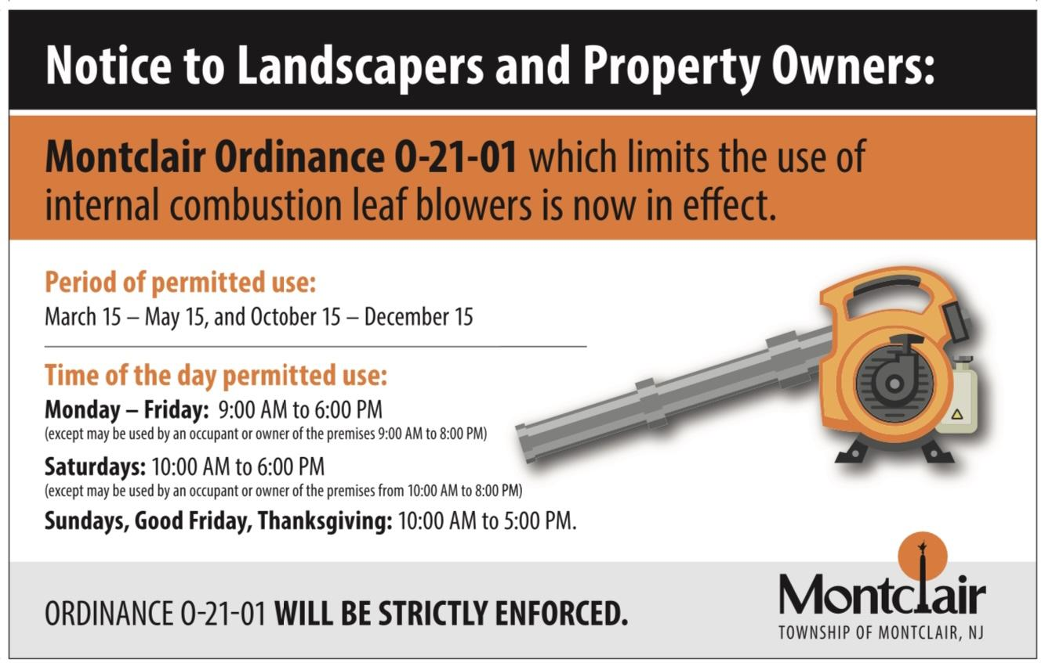
I support a full year-round ban with a 12-18 month phase in. Township equipment included.

Slide 38

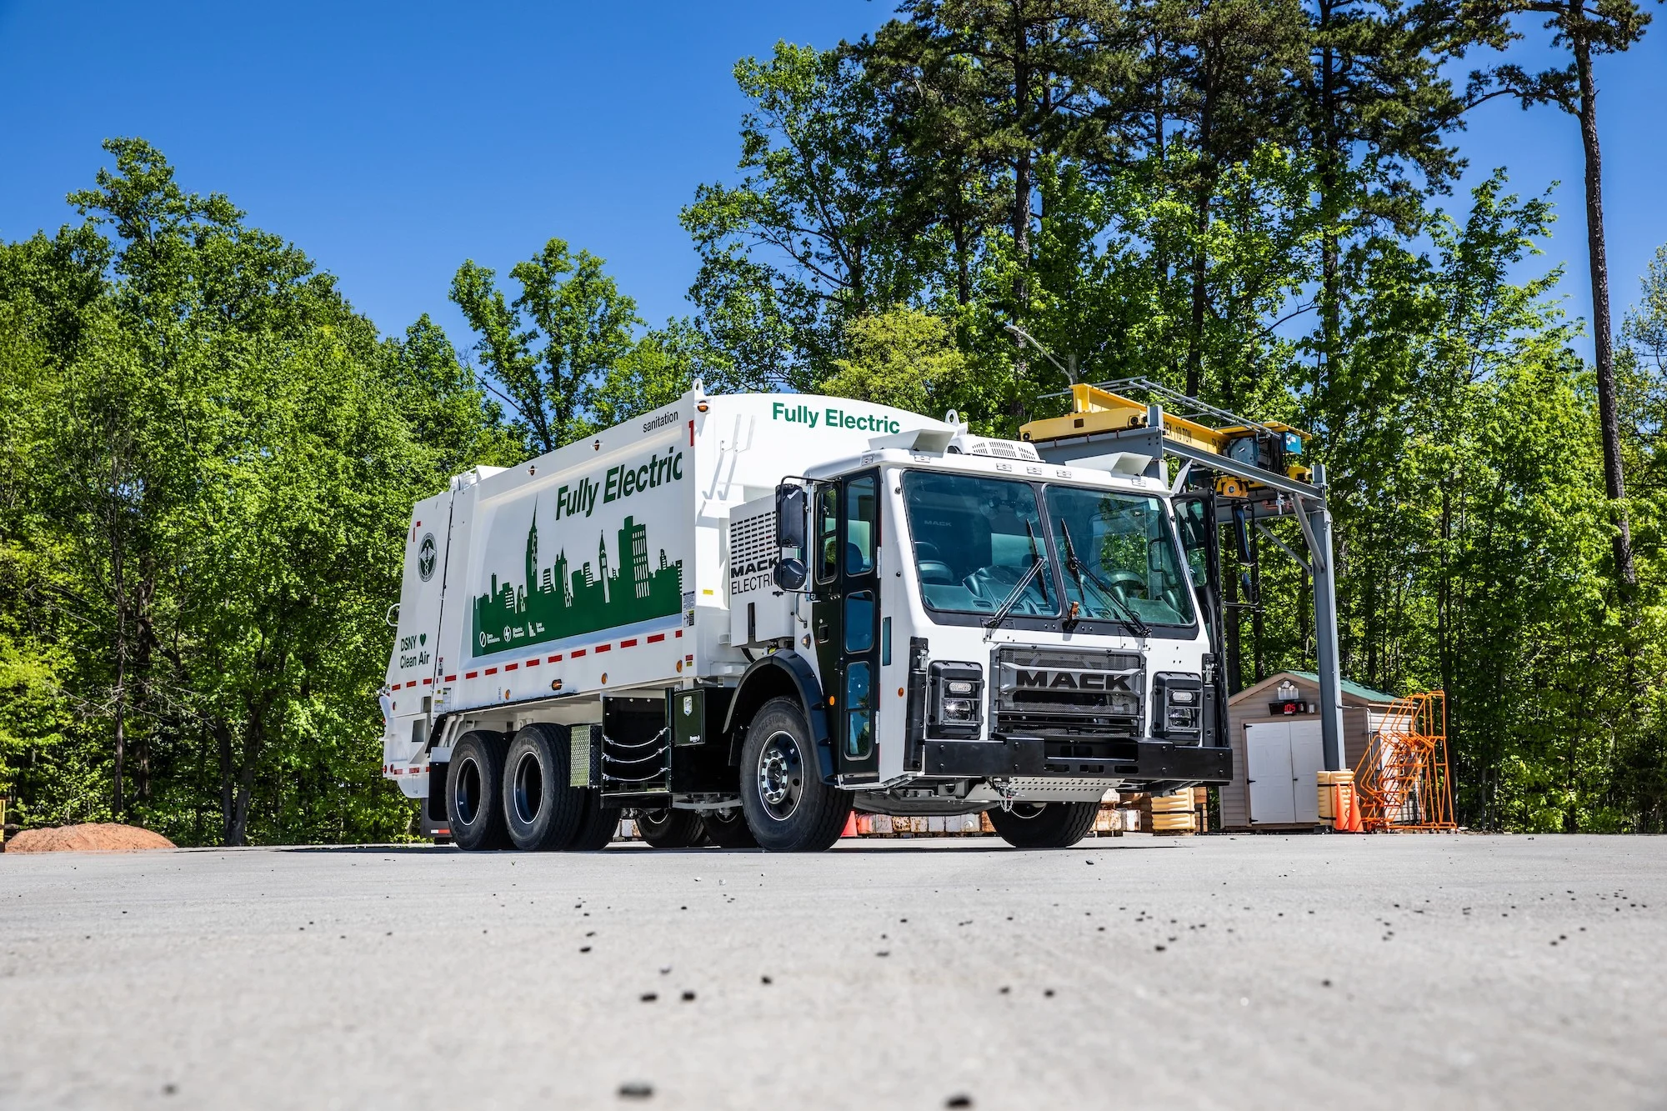

Environmental Values
We should and can have:
Composting Drop-Off Program by mid-year 2023
Curbside Composting Pick-Up by 2026
10-Year Phase-In for Electric Municipal Vehicles
  Trash trucks, fire trucks, police vehicles, and everyday cars
  No internal combustion vehicle purchases after 2025
  All vehicles must be hybrid or electric by 2035
Residential network of subtle bike lanes and crossings by 2025
Comprehensive Emissions Data Capture and Reduction Goals

Slide 39
Q & A
Raise Your Hand for a Microphone
Virtual Attendees Can Text a Question to 973-747-8259
To engage with me visit peteryacobellis.com

